Slide 1
Daniel Schroeder’s
Pitch Games
Presented by Daniel Schroeder

Slide 2
What Is It?
A series of mini games controlled by the pitch of the player’s voice
One of the mini games is controlled by MIDI files
Developed in C# using the .Net framework and GDI+ for the graphics

Slide 3
Why Play Games Using
The Pitch of Your Voice
Because we can
New interesting method of interaction with video games
Some games already do this
  Rock Band – Rating based on pitch, rhythm, and phoneme detection
  Racing Pitch

Slide 4
Detecting the Player’s Pitch
PD is used to detect the pitch of the player’s voice, using the fiddle~ object
Both pitch and amplitude are obtained from using fiddle~
Data passed to my game over a UDP port using OSC (Open Sound Control)

Slide 5
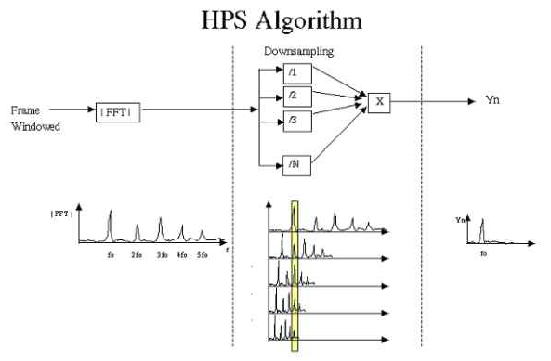
Harmonic Product Spectrum

Slide 6
Obtaining The MIDI Information
3. Extract MIDI
information
1. Select and play MIDI file
in embedded WMP
2. MIDI passed via LoopBe1
Virtual MIDI port
PD
Video Game
4. MIDI information
passed via OSC

Slide 7
Results
Can control parameters of a game by changing the pitch of your voice
Fun for player, maybe not so much for observers (can be annoying to listen to)

Slide 8
Demo and Questions

